Slide 1

DAYANANDA SAGAR ACADEMY OF TECHNOLOGY AND MANAGEMENT
Department of Electronics and Communication Engineering
(Affiliated to Visveswaraya Technological University, Belagavi & Approved by AICTE, New Delhi)
Udayapura, Kanakapura Road, Bangalore-560082
2021-2022
PROJECT ON
“IoT and Wireless Sensor Network (WSN) based Data Logger System with rain prediction using ML”
Under the Guidance of
Mr. Ramakrishna S
(Associate Professor, Dept. of ECE)
Project Coordinator
Dr. Siddalingappagowda Biradar
(Associate Professor, Dept. of ECE)
Submitted By-
Aakarsh Satyam (1DT18EC002)
Lavanya R (1DT18EC043)
M V Narasimha Prasad (1DT18EC047)
Naveen N N M (1DT18EC053)

Slide 2

OUTLINE
Introduction
Literature Survey
Problem Statement
Objectives
Block Diagram
Hardware used
Software used
Circuit Diagram and Explanation
Project Implementation
Communication Protocols
Project Implementation(ML part)
Experimental Results
Conclusion
References

Slide 3

INTRODUCTION
Agriculture is the backbone of India.
18% of India’s Gross Domestic Production (GDP) is accounted by agriculture.
Indian agriculture provides employment to 50% of the country’s workforce.
Technological advances are done in various fields.
But not much is implemented in agricultural field.
Collect data from soil, atmosphere, plants, etc. accurately.
Wireless Sensor Network (WSN) based data logger system using ESP-NOW protocol.
To collect data accurately from agricultural field.

Slide 4

LITERATURE SURVEY
Sl. No | Title & author | Journal & year | Observations | Take away points
1. | “Design and Development of Wireless Sensor Network based data logger with ESP-NOW protocol” Authors: Koushik M S, Srinivasan M, Et al. | IEEE-2021 | This system aims at monitoring and collecting data accurately. By using Wireless Sensor Network (WSN) based data logger system with ESP-NOW protocol data was collected in a dynamic and flexible way. | Sensor node and master node for data logging. WSN based effective data collection. Storage of data in real time database.

Slide 5
Sl. No | Title & author | Journal & year | Observations | Take away points
2. | “Machine Learning based soil moisture prediction for Internet of Things based Smart Irrigation System” Authors: Gursimran Singh; Deepak Sharma, Et al. | IEEE-2019 | Soil moisture prediction using capacitive moisture sensor. ML algorithm for predicting soil moisture | Internet of Things for ease of use Linear regression algorithm. Smart Irrigation system

Slide 6
Sl. No. | Title & author | Journal & year | Observations | Take away points
3. 4. | “Smart farming system using sensors for agricultural task automation” Authors: Chetan Dwarkani M; Ganesh Ram R, Et al. An IOT based Smart Irrigation System using Soil Moisture and Weather Prediction” Authors: V. Balaji, Dr. S. Velmurugan, Et al. | IEEE-2018 IEEE -2019 | Agricultural smart farming. Formation of sensor nodes. This paper proposes an IoT based smart irrigation architecture along with a hybrid machine learning based approach to predict the soil moisture. | Features used in smart farming Task automation using sensors and actuators Data logging for weather prediction. Real-Time Data monitoring To Gain knowledge about technology used

Slide 7

PROBLEM STATEMENT
Internet of things (IoT) and machine learning (ML) based solution are revolutionizing many fields.
Aims to develop effective and low-cost real-time monitoring system.
The IoT and ML techniques can be used to optimize water usage in irrigation.
Predicting the future soil moisture.

Slide 8
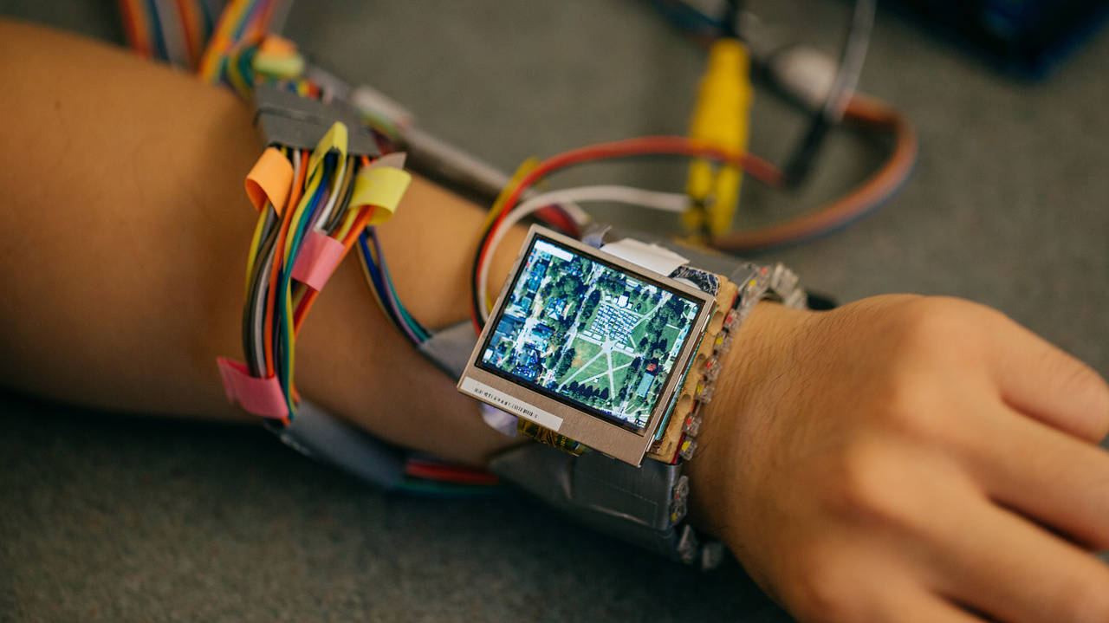
OBJECTIVES
Collect data accurately with less errors and hardware.
Create an effective and low-cost monitoring system.
WSN based Data logger system.
Collect data using sensor node.
Sensor node consist: humidity, temperature, rain sensor and soil moisture sensor.
Data is sent to real-time database.
Linear Regression is used to predict rain.

Slide 9
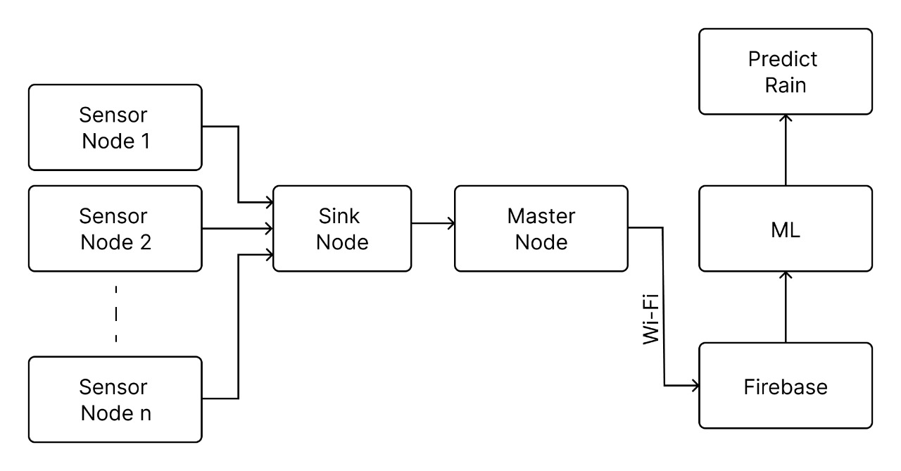
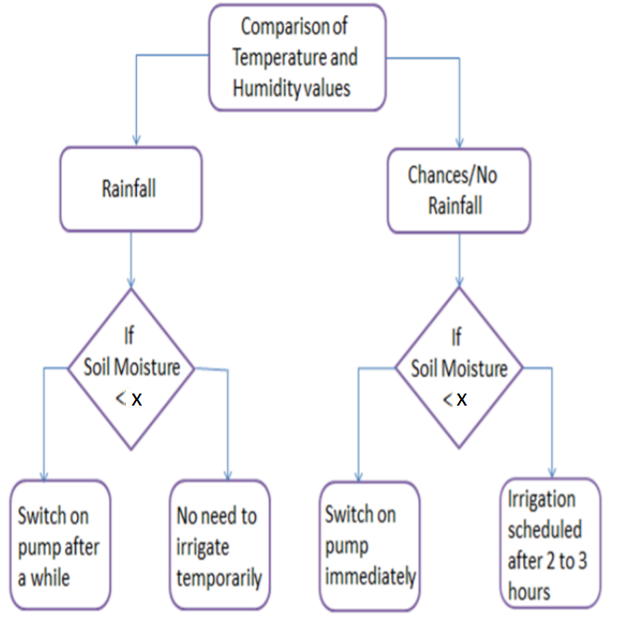
BLOCK DIAGRAM
FLOWCHART

Slide 10
HARDWARE USED
NodeMCU (ESP8266) (as Sensor Node and Master Node)
ESP32 (As Sink Node)
Sensors (Temperature and Humidity - DHT11, rain sensor, Soil moisture sensor)
Battery (Li ion 3.7V, 2200mAh)
Battery charging circuit (TP4056)
Zero Printed Circuit Board (Zero PCB)

Slide 11

SOFTWARE USED
Wireless Sensor Network
Database (by Google: Firebase)
Python (NumPy, Pandas, Matplotlib)
ML (Linear Regression)
Arduino IDE
Data set for rain prediction is obtained from: https://www.meteoblue.com/en/weather/archive/export/bengaluru_india_1277333)

Slide 12
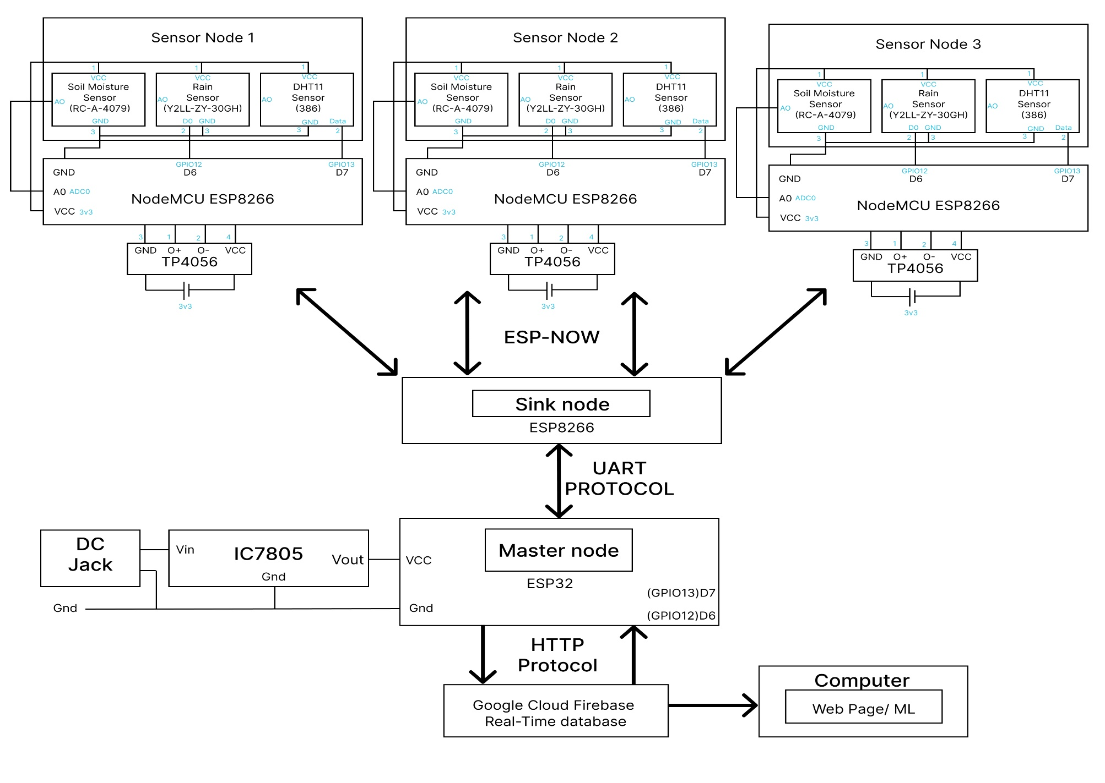
CIRCUIT DIAGRAM

Slide 13
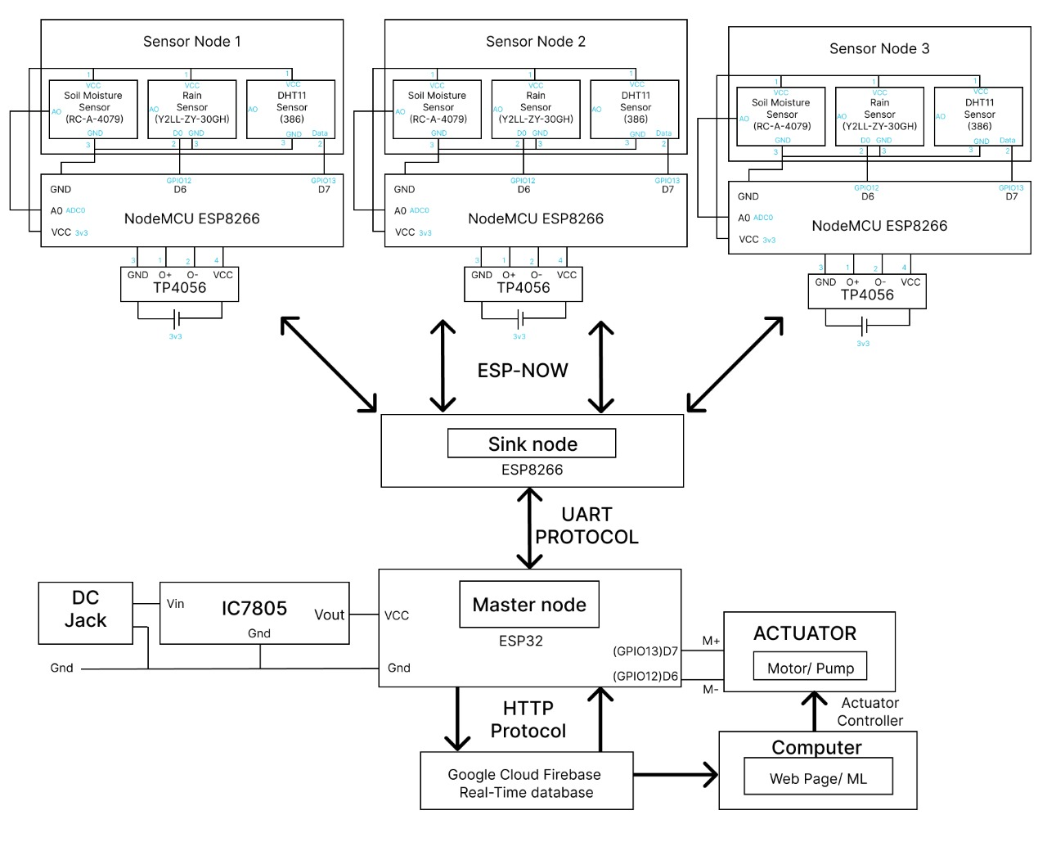
CIRCUIT DIAGRAM EXPLANATION
Sensor Node collects data from Sensors
Soil Moisture Sensor (1 wire protocol)
Rain Sensor (1 wire protocol)
DHT11 sensor (1 wire protocol)
The data is collected by ESP8266 and sends to Sink Node (ESP-NOW protocol)
TP4056 is a battery charging circuit
The can be operated by AC power source and by batteries

Slide 14
SENSOR NODE CONFIGURATION
As soon as the sensor nodes are powered ON the NodeMCU looks for MAC address of Receiver Node (Master Node)
Soil Moisture Sensor collects data and starts to send to NodeMCU
Rain Sensor collects data and starts to send to NodeMCU
DHT11 sensor collects data and starts to send to NodeMCU

Slide 15
CIRCUIT DIAGRAM EXPLANATION
All Sensor Nodes work similar
Sensors can be customized according to farmer’s need
All the Sensor Nodes send data through ESP8266 to the Sink Node through ESP-NOW protocol
ESP-NOW protocol works based on Vendor Action Frame
The sink Node acts as a gateway to push data to Master Node

Slide 16
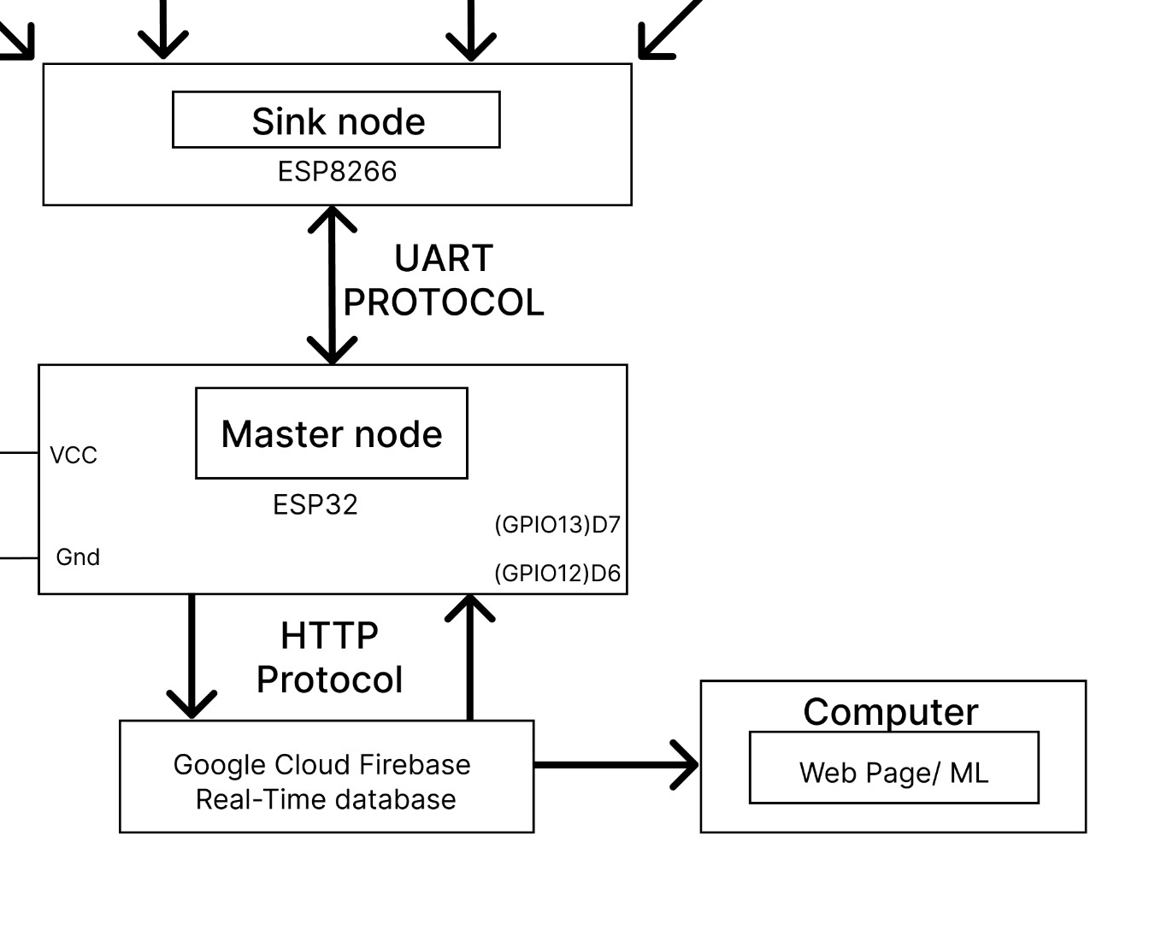
CIRCUIT DIAGRAM EXPLANATION
The ESP-NOW protocol is a Proprietary protocol of Espresif Systems
The Sink Node pushes the Data to the Master node using UART Protocol
Master Node Receives the Data from Sink Node Serially
The data is sent from Master Node to Database using HTTP protocol
The Database is accessed by an end device (computer by using webpage)
This data can be used to control Actuator
Actuator is connected to Master Node

Slide 17
SINK AND MASTER NODE CONFIGARATION
As soon as the Sink node is powered ON, it identifies the sensor nodes that are sending data using ESP-NOW protocol.
The Sensor nodes directly sends the data to Sink Node using it’s MAC address which is in the frame format of ESP-NOW protocol
The Sink Node then sends this data to Master Node using UART Protocol
Master Node sends the same using HTTP protocol to Could database

Slide 18
PROJECT IMPLEMENTATION
Data collection: TEST MODE – 1/minute, DEPLOYMENT mode – 1/hour.
Power management: AC power supply → Li ion batteries
Feature: Dual mode powering: battery supply and AC power supply.
Strength: Can connect up to 20 Sensor nodes
Connectivity Range: 20 to 30 meters.
Flexibility: Master node automatically recognizes and creates a new node.
Robust build: Failure of few sensor nodes does not affect the system.
Easy accessibility of data: By using Cloud Storage (Firebase Real-time database).
Replicating Sensor node: very easy and Sensor nodes can be customized according to need.

Slide 19
COMMUNICATION PROTOCOLS
One wire communication (to send data from Sensor to Microcontroller)
ESP-NOW protocol (to send data from Sensor Node to Sink Node)
UART protocol (Communication between Sink Node and Master Node)
HTTP protocol (Sending data from Master Node to Google cloud storage)

Slide 20
PROJECT IMPLEMENTATION (ML part)
Accessing Data from Master Node or Online database
The Machine learning model for predicting rain at a particular time is going to be done by the linear regression model
Linear regression is the method of plotting data points onto a graph.
Data Enrichment/Data Cleaning
Feature Selection (if necessary)

Slide 21
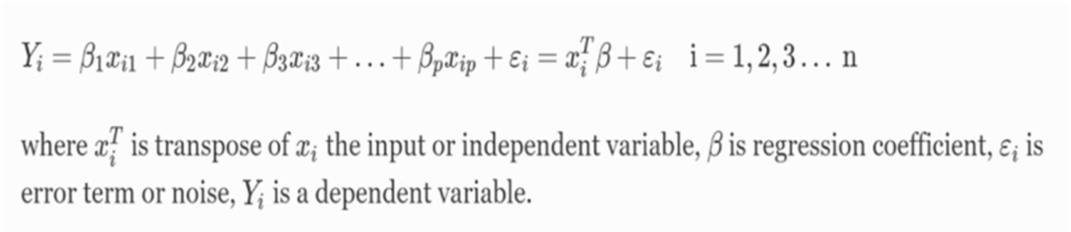
Algorithm (ML part)
Using the known environmental factors as input, the supervised machine learning technique of linear regression is utilised to forecast the unknown daily rainfall amount
Multiple explanatory or independent variables (X) and a single dependent indicated by Y, were used in the multivariate linear regression.
Hence, the general equation of the multiple linear regression is given as:

Slide 22
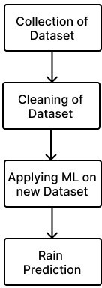
Flowchart (ML part)
The complete flow of process of the proposed methodology is shown in below figure.

Slide 23
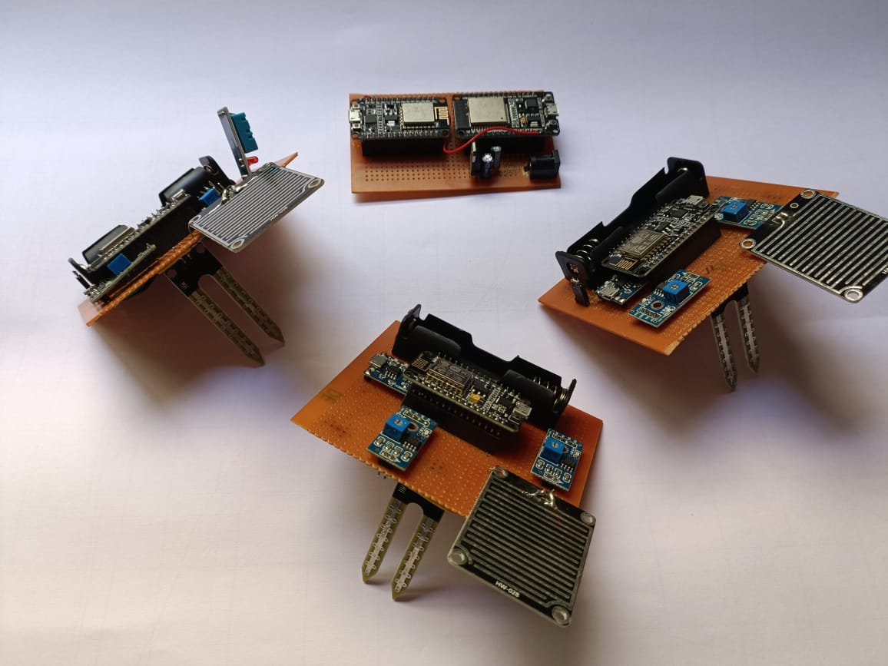
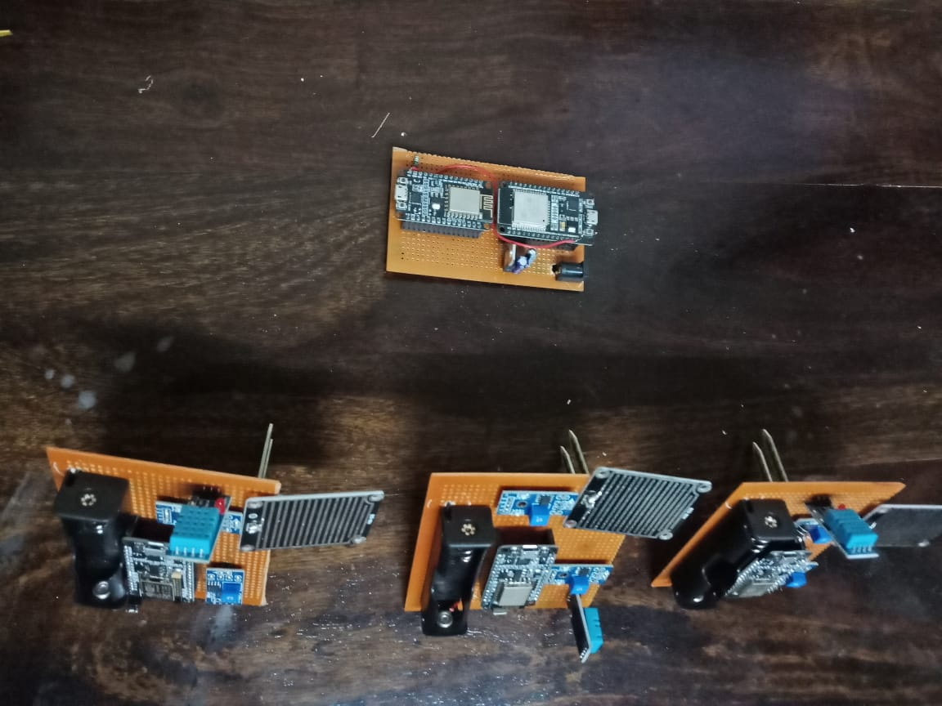
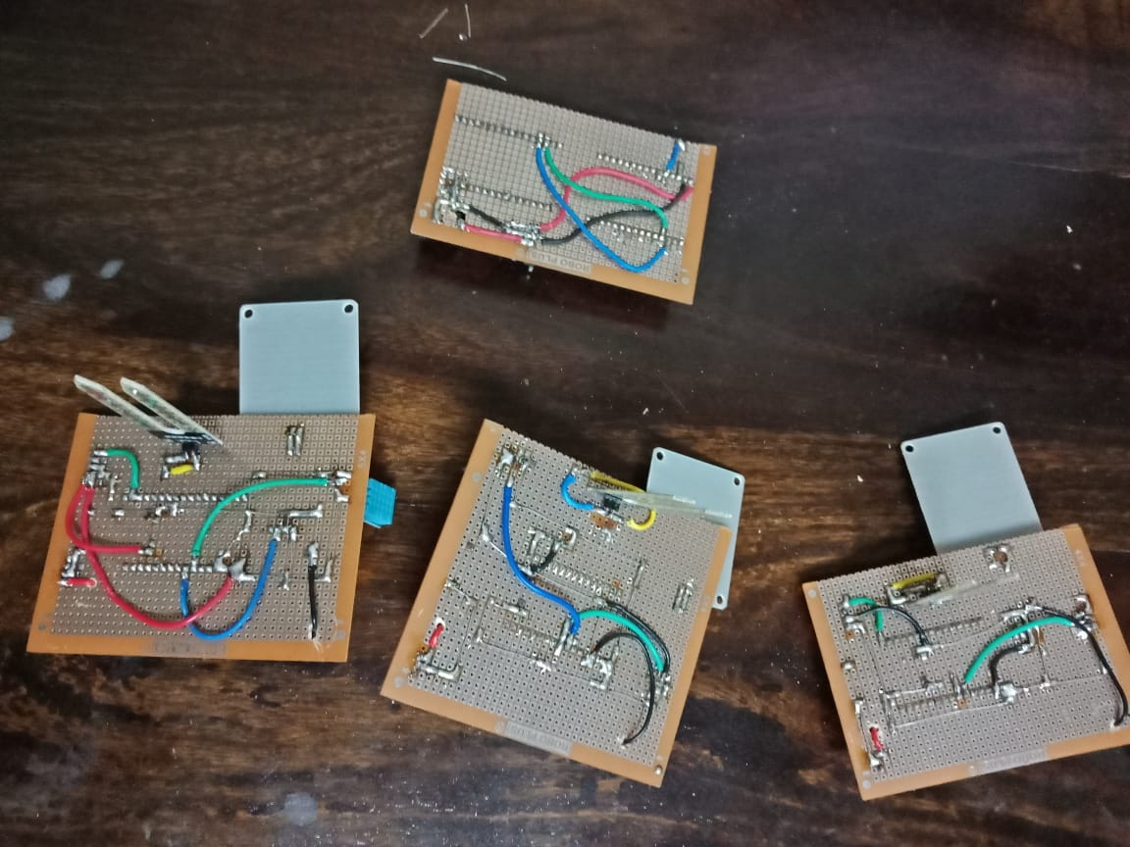
EXPERIMENTAL RESULTS

Slide 24
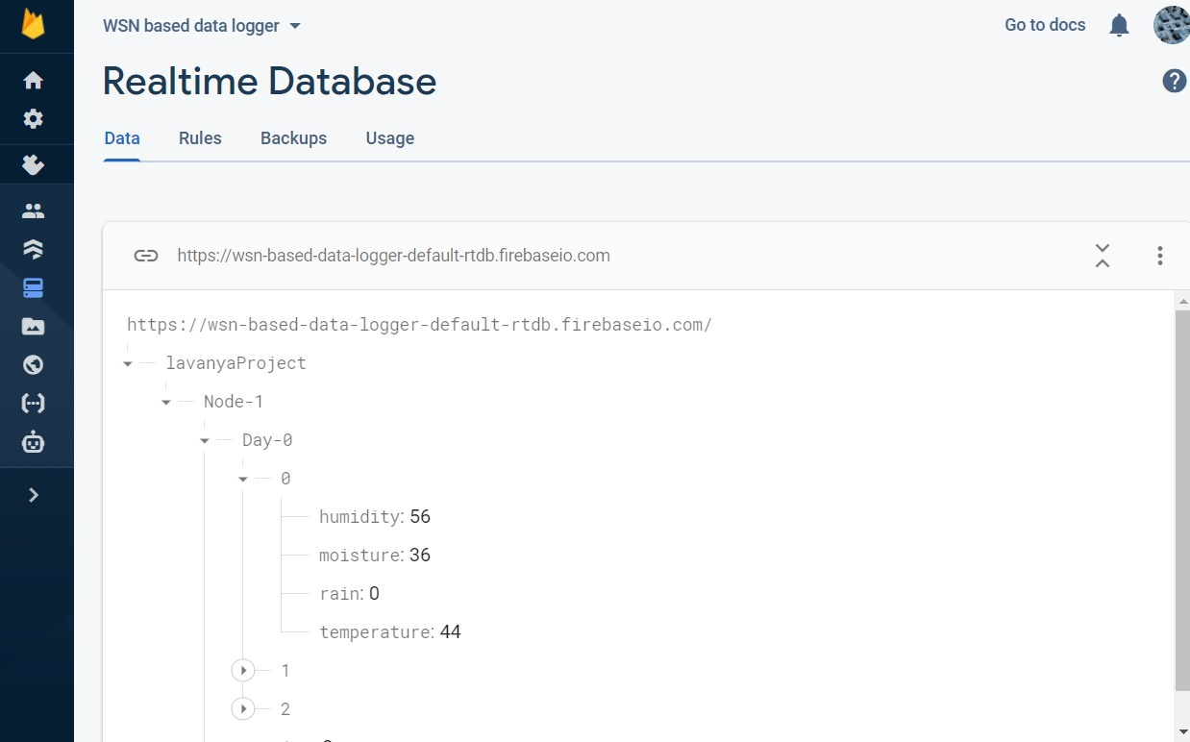
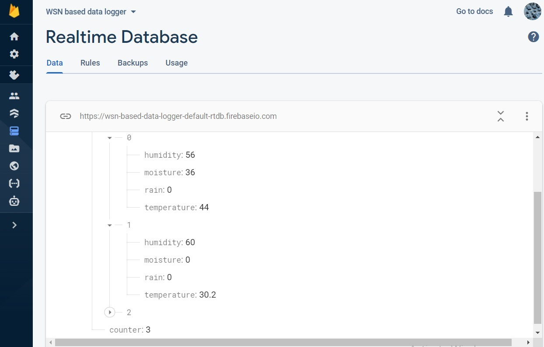
EXPERIMENTAL RESULTS
fig 1 : Firebase Output 1
fig 2 :Firebase Output 2

Slide 25
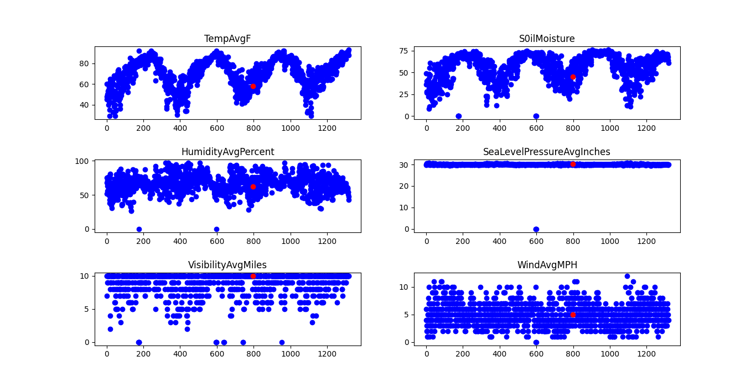
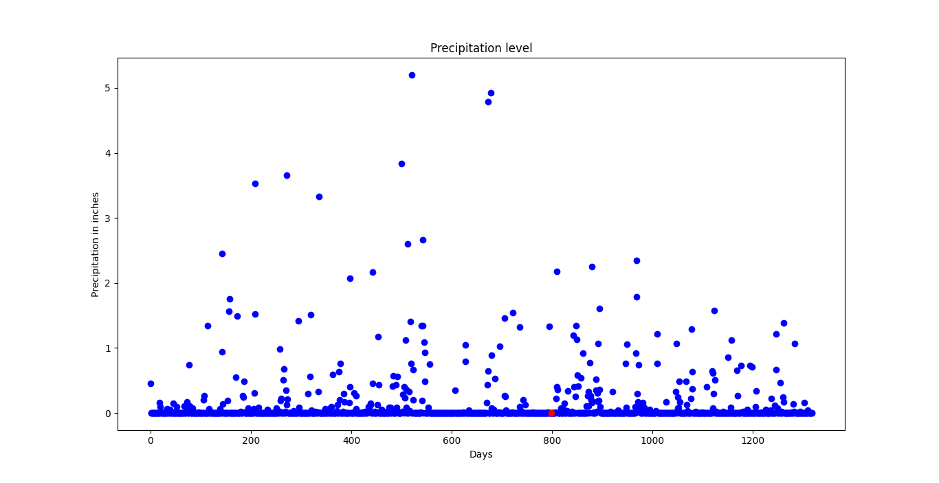
ML RESULTS
fig 1 : Firebase Output 1
fig 2 :Firebase Output 2

Slide 26
ML RESULTS
fig 1 : Firebase Output 1
fig 2 :Firebase Output 2

Slide 27
EXPERIMENTAL RESULTS
Quality metrics:
The important parameter in implementing such systems practically would be battery life management
The battery needs to be charged and recharged every now and then to maintain the sensor nodes.
Few experiments were performed to measure the current consumption of sensor nodes while being used and while in idle state.
While performing the experiment, the data was transmitted once per hour from the sensor node to the master node.

Slide 28
EXPERMENTAL RESULTS
Quality metrics:
State of the Sensor Node | Current Consumed
While transmitting the data | 170mA
In idle state | 80mA
When in Sleep Mode (No Wi-Fi connectivity) | 10mA

Slide 29
CONCLUSION
This project gives effective data logging system using WSN
Provides Easy-to-access Real-time data monitoring using Firebase
Stores the collected data for analysis
Predicts rain
Real-time weather monitoring system

Slide 30
REFERENCES
[1]. K. M. S, S. M, L. R, A. S and S. Setty, "Design and Development of Wireless Sensor Network based data logger with ESP-NOW protocol," 2021 6th International Conference for Convergence in Technology (I2CT), 2021, pp. 1-5, doi: 10.1109/I2CT51068.2021.9417914.
[2]. G. Singh, D. Sharma, A. Goap, S. Sehgal, A. K. Shukla and S. Kumar, "Machine Learning based soil moisture prediction for Internet of Things based Smart Irrigation System," 2019 5th International Conference on Signal Processing, Computing and Control (ISPCC), 2019, pp. 175-180, doi: 10.1109/ISPCC48220.2019.8988313.
[3]. Chetan Dwarkani M, Ganesh Ram R, Jagannathan S and R. Priyatharshini, "Smart farming system using sensors for agricultural task automation," 2015 IEEE Technological Innovation in ICT for Agriculture and Rural Development (TIAR), 2018, pp. 49-53, doi: 10.1109/TIAR.2015.7358530.
[4]. Goap Amarendra, Deepak Sharma, A. K. Shukla and C. Rama Krishna, "Comparative Study of Regression Models Towards Performance Estimation in Soil Moisture Prediction", International Conference on Advances in Computing and Data Sciences, pp. 309-316, 2018
[5]. S. Chandra, S. Bhilare, M. Asgekar and R. B. Ramya, "Crop Water Requirement Prediction in Automated Drip Irrigation System using ML and IoT," 2021 4th Biennial International Conference on Nascent Technologies in Engineering (ICNTE), 2021, pp. 1-4, doi: 10.1109/ICNTE51185.2021.9487767
[6]. R. Singh, S. Srivastava and R. Mishra, "AI and IoT Based Monitoring System for Increasing the Yield in Crop Production," 2020 International Conference on Electrical and Electronics Engineering (ICE3), 2020, pp. 301-305, doi: 10.1109/ICE348803.2020.9122894.
[7]. J. Mabrouki, M. Azrour, D. Dhiba, Y. Farhaoui and S. E. Hajjaji, "IoT-based data logger for weather monitoring using arduino-based wireless sensor networks with remote graphical application and alerts," in Big Data Mining and Analytics, vol. 4, no. 1, pp. 25-32, March 2021, doi: 10.26599/BDMA.2020.9020018.

Slide 31
[8]. Gutiérrez Joaquin, Juan Francisco Villa-Medina, Alejandra Nieto-Garibay and Miguel Angel Porta-Gándara, "Automated irrigation system using a wireless sensor network and GPRS module", IEEE transactions on instrumentation and measurement 63, no. 1, pp. 166-176, 2013.
[9]. Goldstein Anat, Lior Fink, Amit Meitin, Shiran Bohadana, Oscar Lutenberg and Gilad Ravid, "Applying machine learning on sensor data for irrigation recommendations: revealing the agronomist's tacit knowledge", Precision agriculture 19, no. 3, pp. 421-444, 2018.
[10]. oopaei Mehdi, Paul Rad and Kim-Kwan Raymond Choo, "Cloud of things in smart agriculture: Intelligent irrigation monitoring by thermal imaging", IEEE Cloud computing 4, no. 1, pp. 10-15, 2017.
[11]. Goap Amarendra, Deepak Sharma, A. K. Shukla and C. Rama Krishna, "Comparative Study of Regression Models Towards Performance Estimation in Soil Moisture Prediction", International Conference on Advances in Computing and Data Sciences, pp. 309-316, 2018
[12]. S. A. O’Shaughnessy and Steven R. Evett, "Canopy temperature based system effectively schedules and controls center pivot irrigation of cotton", Agricultural Water Management 97, no. 9, pp. 1310-1316, 2017. doi: 10.1109/ICNTE51185.2021.9487767
[13]. R. Singh, S. Srivastava and R. Mishra, "AI and IoT Based Monitoring System for Increasing the Yield in Crop Production," 2020 International Conference on Electrical and Electronics Engineering (ICE3), 2020, pp. 301-305, doi: 10.1109/ICE348803.2020.9122894.
[14]. J. Mabrouki, M. Azrour, D. Dhiba, Y. Farhaoui and S. E. Hajjaji, "IoT-based data logger for weather monitoring using arduino-based wireless sensor networks with remote graphical application and alerts," in Big Data Mining and Analytics, vol. 4, no. 1, pp. 25-32, March 2021, doi: 10.26599/BDMA.2020.9020018.

Slide 32
THANK YOU

